Slide 1
IPM tools for Rhopalosiphum padi: forecasting, monitoring, weather radars and suction traps
Irmeli Markkula
MTT Agrifood Research Finland
Plant Production Research

Slide 2
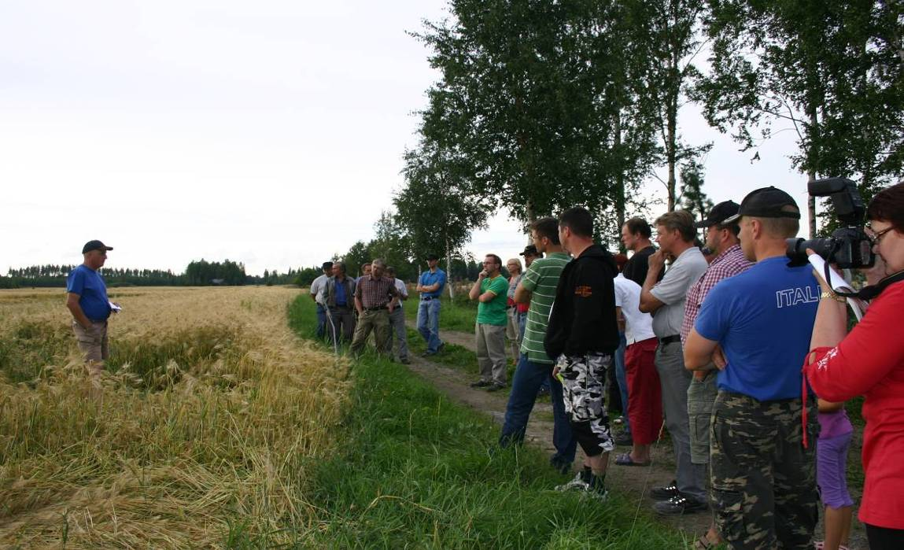
IPM –general principles in use from 2014
IPM = Integrated Pest Management (FAO)
Integration of all available pest control techniques
Prevent the development of pest populations
Economically justified
Reduce risks to
human health
and environment

Slide 3
WHY IPM?
The farmers are moving to integrated plant protection from year 2014 according to the National Action Plan (NAP)
NAP is based on Framework directive 2009/128/EC on sustainable use of
pesticides

Slide 4
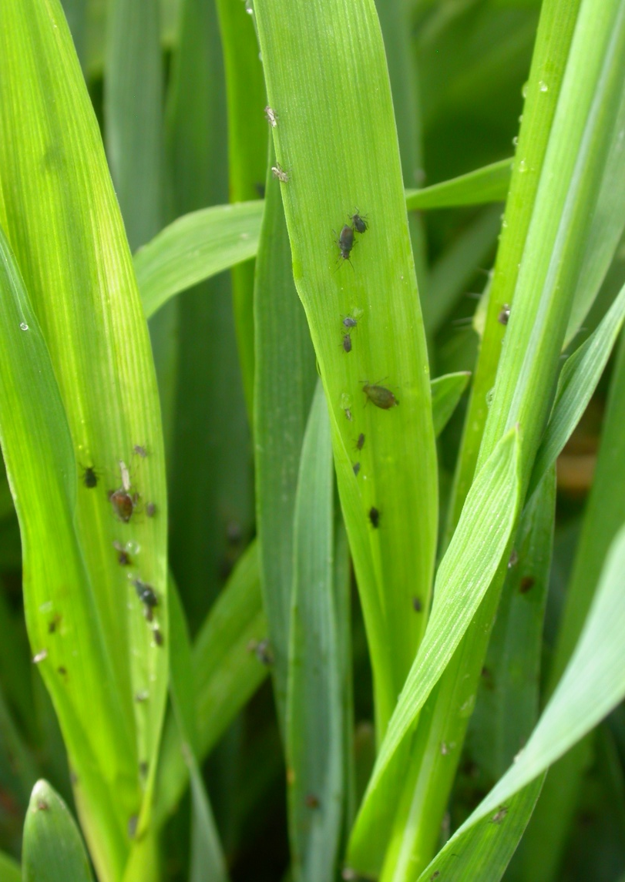
IPM tools for R.padi
forecasting
monitoring
weather radars
suction traps

Slide 5
Counting the winter eggs of R.padi
Forecasting:
the eggs are counted from the same 3-5 trees (P.padus)every year near the fields
20-30 twigs (0,5 m) are collected from every tree
the eggs are counted from 100 buds/tree
the probable mortality is deducted from the amount of eggs

Slide 6
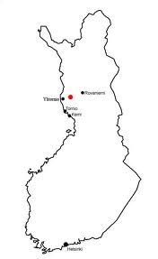
Counting the winter eggs
of R.padi
Mortality values:
The coastal areas of northern
Ostrobothnia
The coastal areas of southern
Ostrobothnia
90%
75%
Central Finland
55%
The coastal areas of
Southern Finland
65%

Slide 7
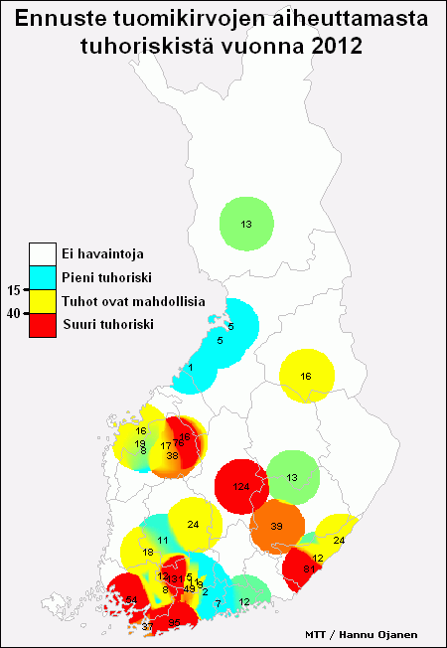
Forecast of R.padi for year 2012
A forecast of R.padi for year 2012
the map was full of aphids
a lot of aphids in bird cherries in spring
however, due to the cold and rainy spring/summer it was not necessary to spray aphids

Slide 8
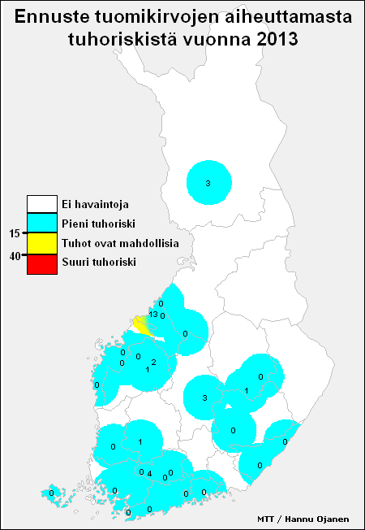
Forecast of R.padi for year 2013
A forecast of R.padi for year 2013
no aphids at all, the
domestic aphid population was very small
aphid migration in late May > also seen
in yellow sticky traps
-together with birch aphids

Slide 9
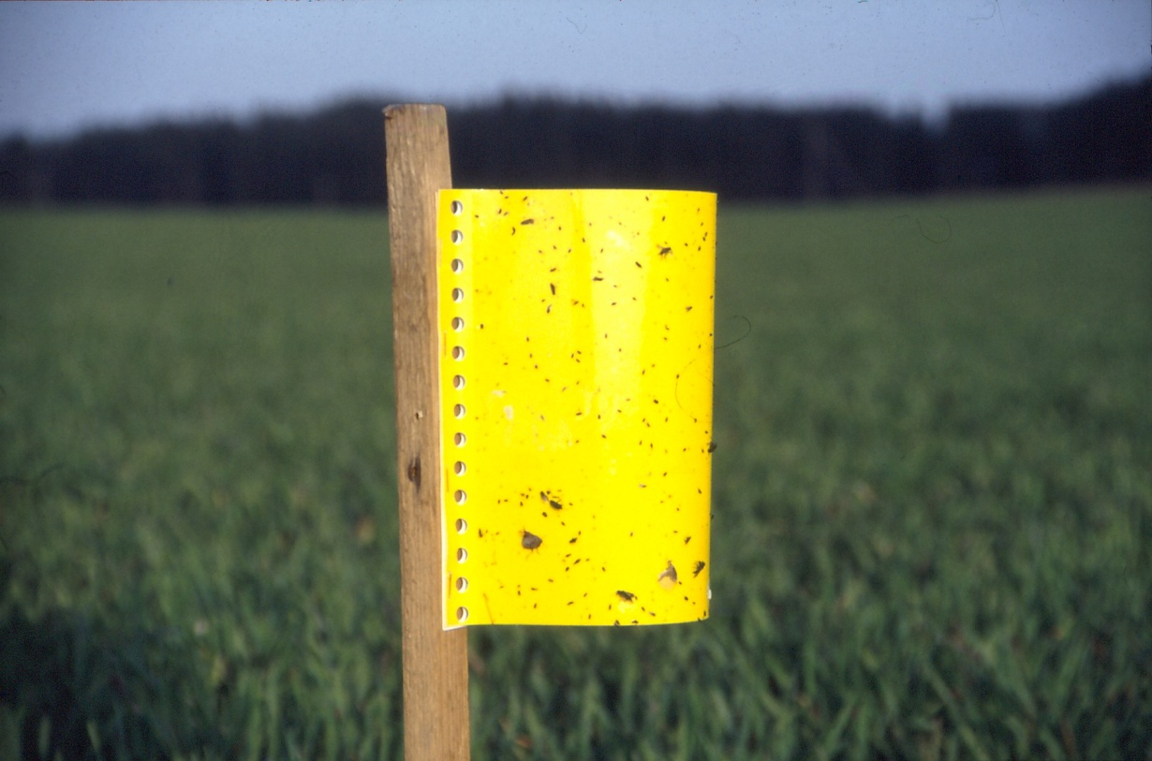
Aphid monitoring:
Yellow sticky traps
(identification difficult)
Counting straight
from the plants
Threshold: when R.padi is found on every fifth plant on tilling stage. Later on the threshold is more than five aphids per straw and while coming into ear the threshold is more than 10 aphids per straw

Slide 10
Cooperation with school farms, advisor organisation and research
Example:
School farms had yellow sticky traps on their fields
Traps were sent to MTT
Information was given to farms and advisors, web pages and agricultural newspapers
This procedure took too much time!

Slide 11
Yellow sticky traps:
 |  | Helsingin yliopisto kelta-ansat 2012
 |  | museopelto
pvm | koodi | R.padi | O.frit | M.destructor | Phyllotreta
4.6.-7.6. | 1 reuna | 11 | 30 | 0 | 0
4.6.-7.6. | 2 reuna | 9 | 9 | 0 | 0
4.6.-7.6. | 3 keskellä | 9 | 2 | 0 | 0
4.6.-7.6. | 4 keskellä | 6 | 7 | 0 | 3
7.6.-11.6. | 1 reuna | 8 | 5 | 0 | 0
7.6.-11.6. | 2 reuna | 4 | 4 | 0 | 0
7.6.-11.6. | 3 keskellä | 1 | 2 | 0 | 2
7.6.-11.6. | 4 keskellä | 6 | 1 | 0 | 10

Slide 12
Weather radars:
Aphid migration
POMO = Multi-scientific applications of polarimetric weather radars
polarimetric radar: it is possible to sort out different forms of rain (water, wet snow, snow, hail, freezing rain) and nonmeteorological targets (insects, birds, sea clutter etc.)
Cooperation with the University of Helsinki, Finnish meteorological Institute and MTT

Slide 13
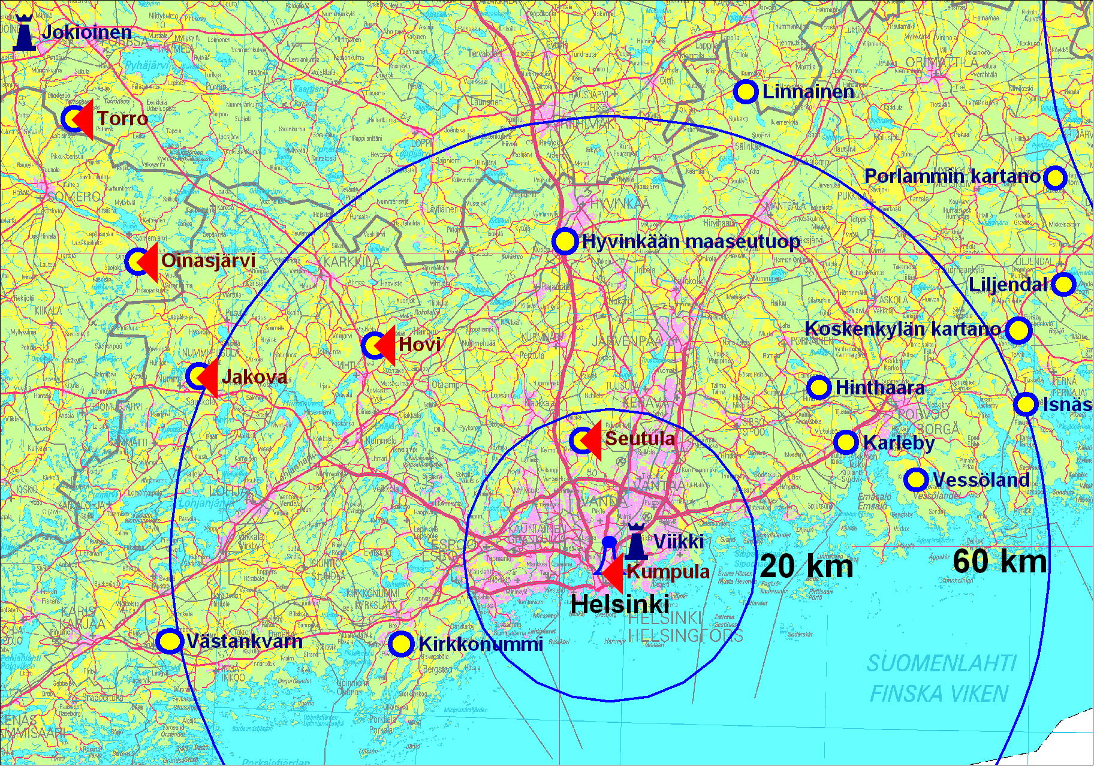
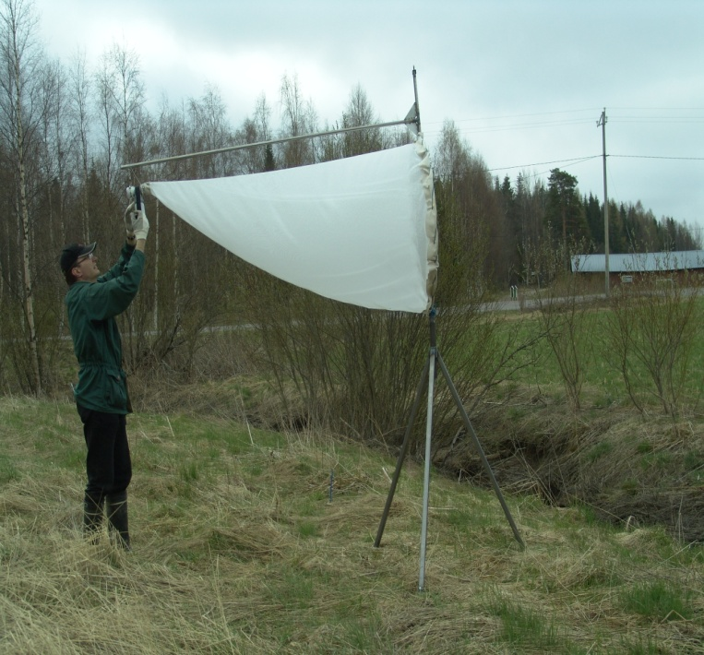
Insect trapping
Aphid migration/weather radars
A field experiment with rotating tow-nets and yellow sticky papers was done

Slide 14
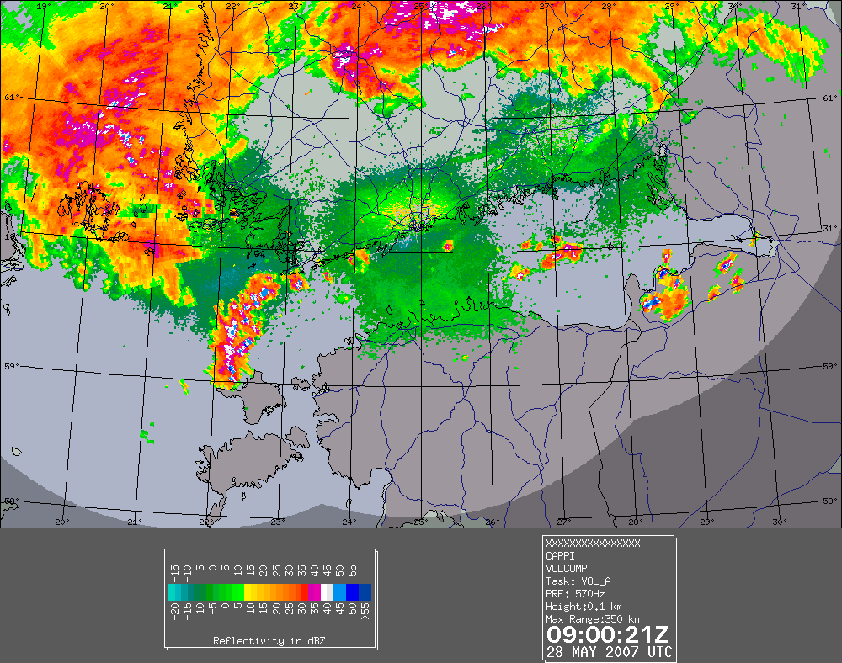
Migrating bird-cherry aphids 28.5.2007

Slide 16
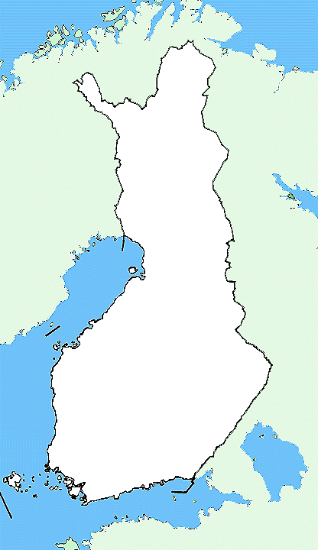
Suction traps in Finland
Tyrnävä
Jokioinen
Viikki

Slide 17
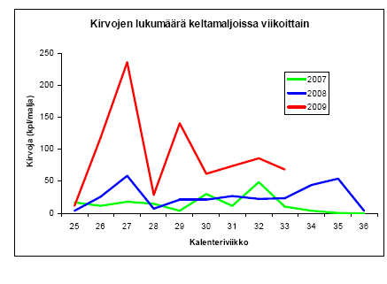
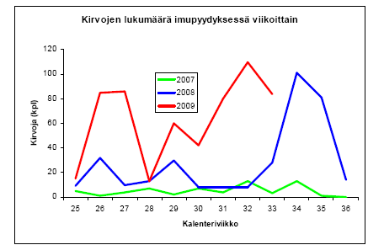
Suction traps
Aphid leaflet!
The University of Helsinki
and MTT Ruukki had a
project where they
monitored the aphids on
three fields and in
Tyrnävä suction trap
The information was
given to the farmers of the surrounding area
Vectors of potato viruses

Slide 18
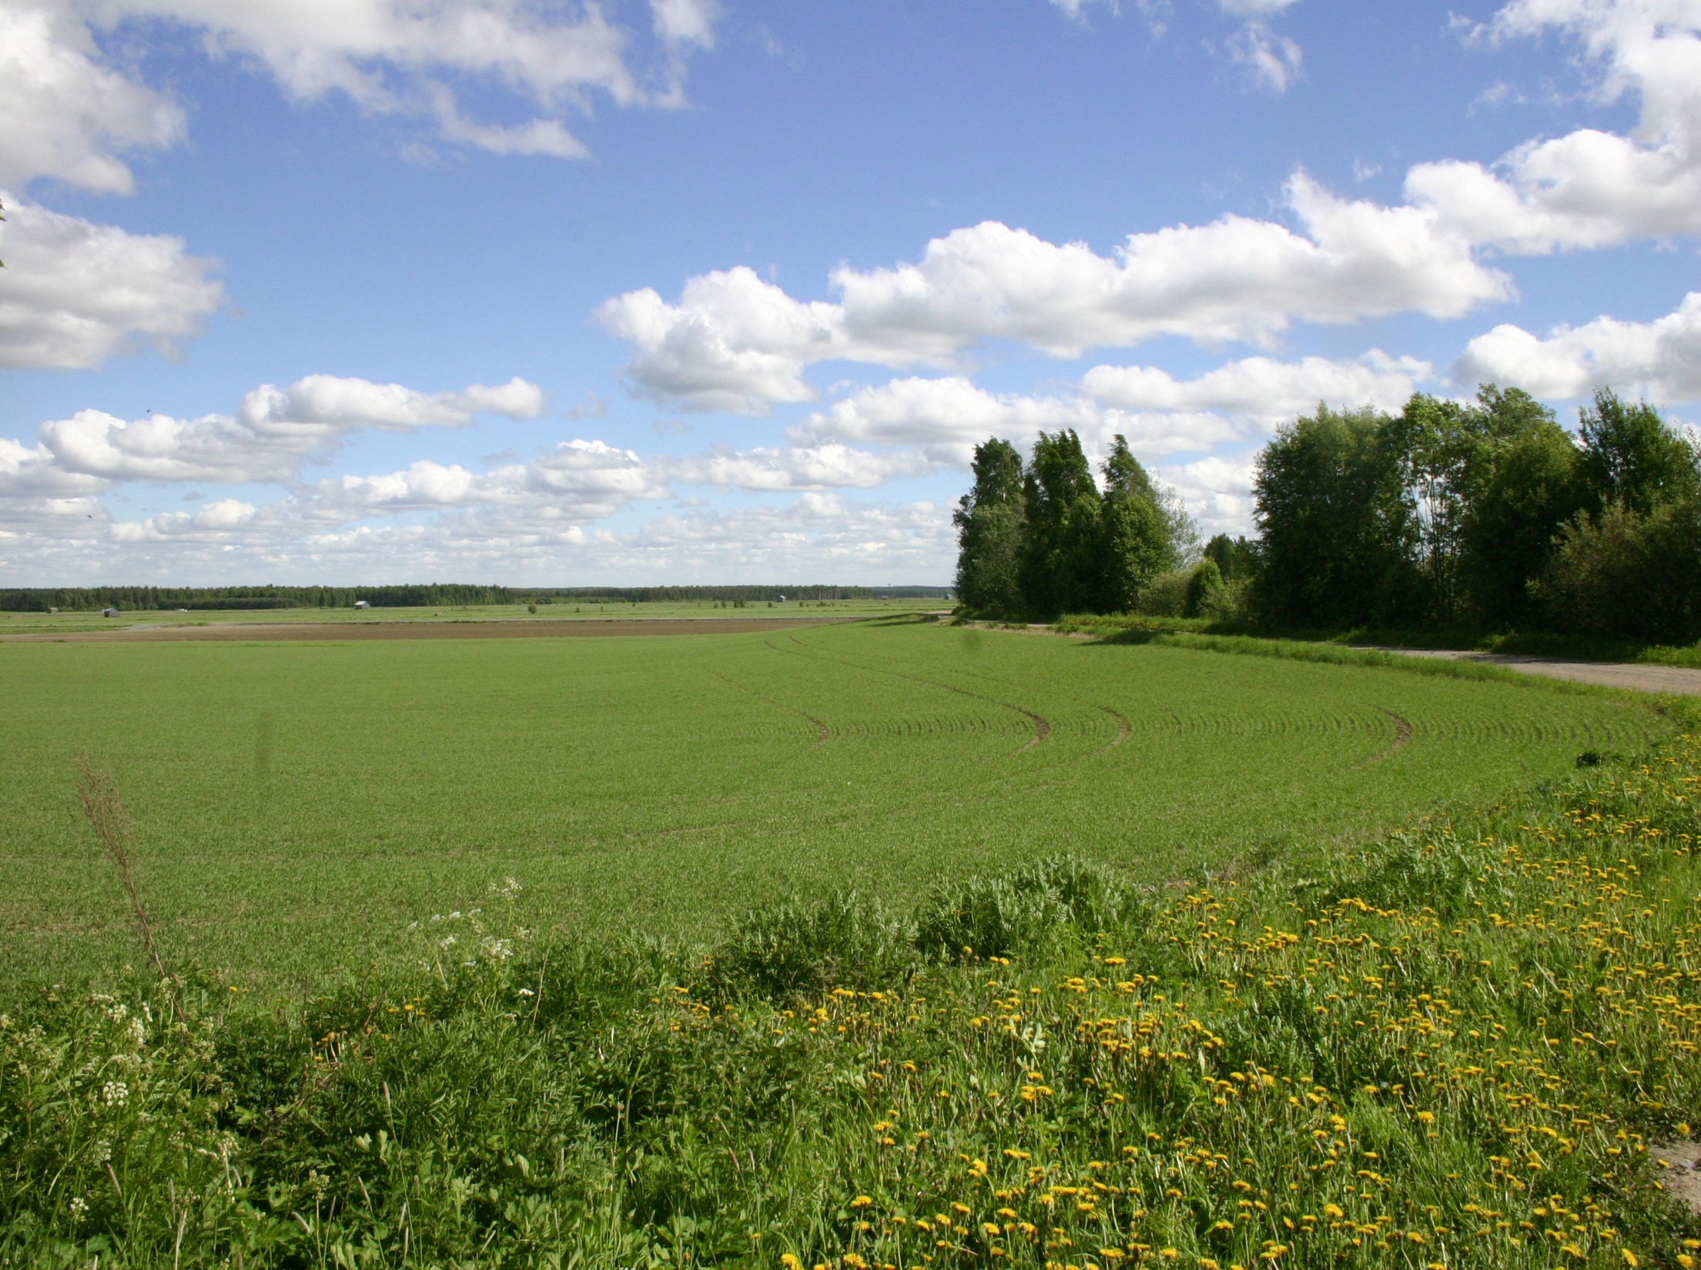
Thank you!

