Slide 1
LIVING ON FARM
A NEW APPROACH OF COMMUNITY SUPPORTED AGRICULTURE (CSA)
Winfried Schäfer
Notes:
I am a German agricultural engineer from Stuttgart Hohenheim, living and working in Finland since 1985.
My area of expertise is engineering in organic farming and energy in agriculture.
So, the question may rise, does my professional background entitle me to present social farming issues?

Slide 2

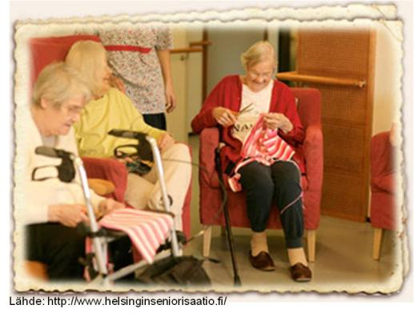
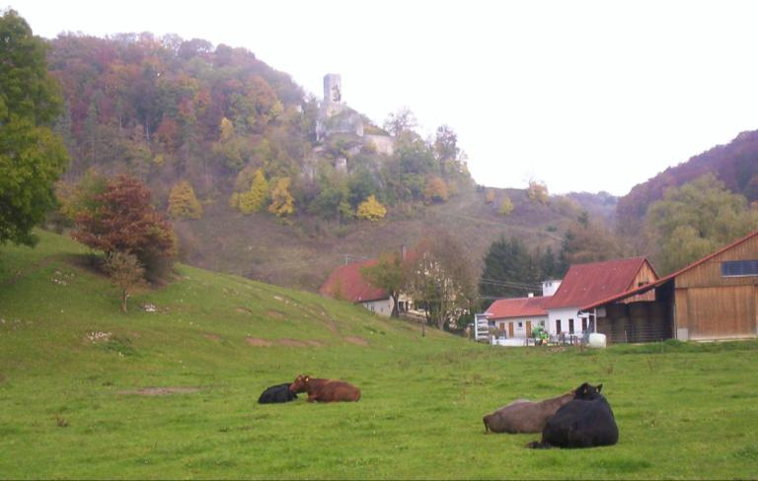
Introduction
58 % of the public consultation participants consi-der the economic and social dimension of organic farming as the most needed areas of research and innovation. (European Commission 2013)
Hospitals, institutions and enterprises caring for people with special needs, even prisons utilise the salutogenetic impact of organic agriculture.
A new CSA phenomenon is that community members do not only procure their food from the farm but also intend to move to the farm as residents, especially elderly.
Objective of the presentation is to evaluate the development of living on farm from an agricultural engineer's point of view focussing on opportunities for elderly in Finland.
Where do you want to
live during the last
phase of your live?
HS 9.11.2010
www.helsinginseniorisaatio.fi
Winfried Schäfer
Notes:
Well, I assume that most of us have once to decide where we want to live in the last phase of our life.
Many stay at their house where they eductated their children or move to their childrens home,
others move back to the place they grew up,
some prefer a residential or a retirement home either at their home town or abroad in a country with warmer climate.

Slide 3
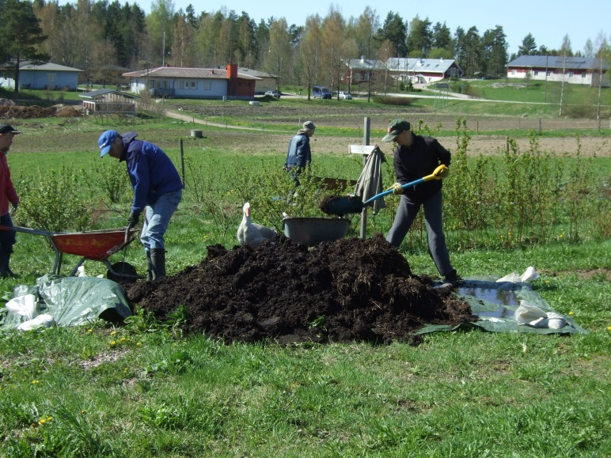
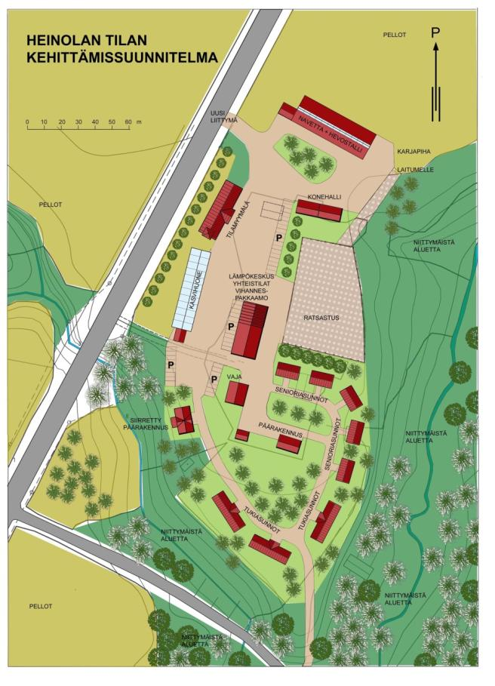
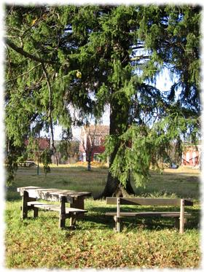
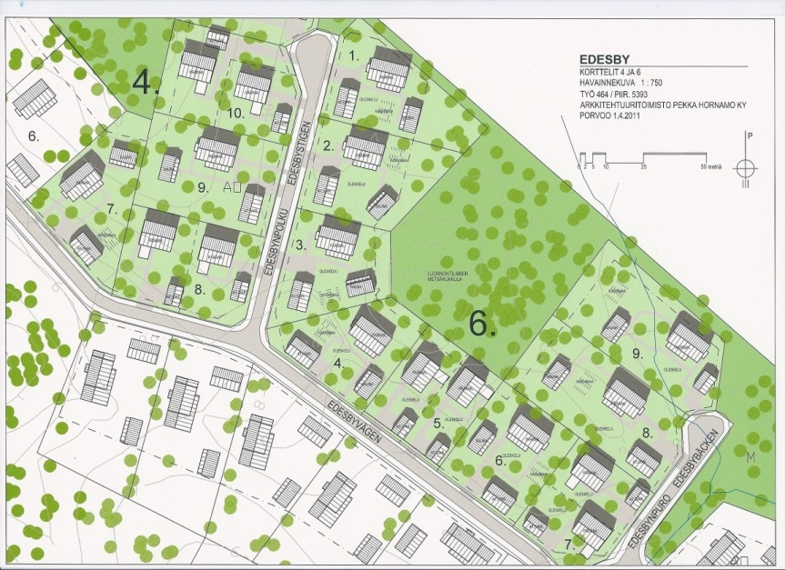
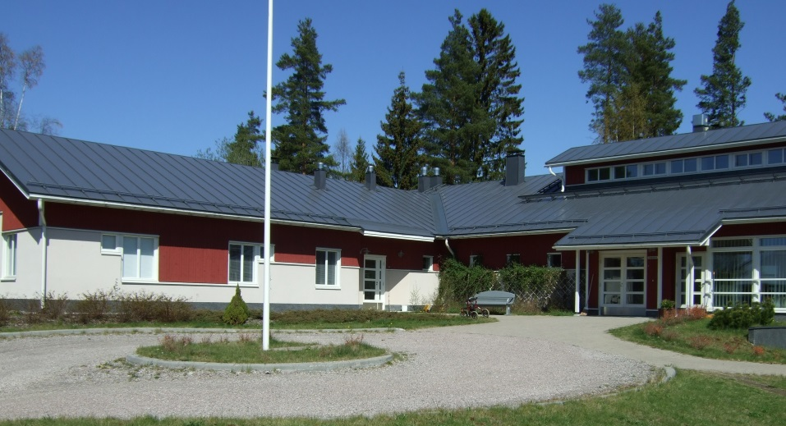
Material and methods
Literature review
Personal communication
Analysis of case studies made during visits on the spot since 2008
Based on the collected material the challenges and problems are shown
Tapola farm: Winfried Schäfer
Heinola farm: Tapani Kivinen
Tapola farm: Winfried Schäfer
Keuruu Ecofvillage
:www.keuruunekokyla.fi
Labby farm: www.edesby.fi
Notes:
I personally prefer as living place a farm, despite I am grew up in a city. Thus, my presentation is rather a personal review about my work on this objective than a research report.

Slide 4
Results
Type | Name, place, web site
Anthroposophical communities | • Myllylähde-yhteisö, Hämeenkoski • Rihun biodynaaminen tila, Heinola, www.phnet.fi/kylat/paistjarvi/kylatoiminta.htm • Sylvia-koti, Lahti, www.sylvia-koti.fi • Tapolan kyläyhteisö, Orimattila, www.tapola-camphill.net/
Communities with a strict eco-philosophy | • Gaijan Luomukylä, Ähtäri, www.gaija.org • Kangasalan Yhteiskylä, Kangasala, www.yhteiskyla.net • Keuruun ekokylä, Keuruu, www.keuruunekokyla.fi/
New on-farm living communities | • Heinolan tila, Haarajoki, http://heinolantila.wordpress.com/ • Labbyn kartano, Isnäs, www.labby.fi, www.edesby.fi/ • Livonsaaren yhteisökylä, Livonsaari, http://www.yhteisokyla.net/ • Svarfvarsin luomutila, Karja, http://www.svarfvars.fi/fi/ • Yhteisökylä Kurjen tila, Vesilahti, http://kurjentila.fi/

Slide 5
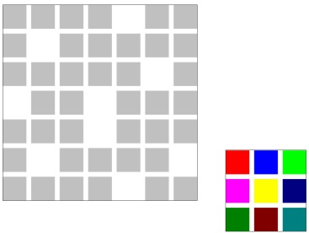
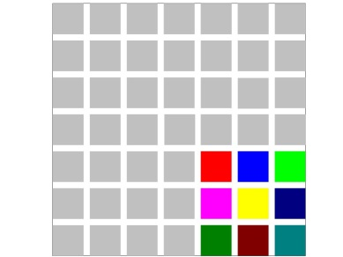
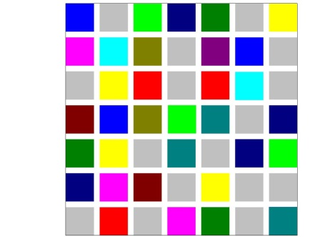
Bridging the gap between scientific knowledge and practise
Science:
Salutogenetic aims correspond to healthy soil and nature and an integrated social work which have a positive impact on people, nature and landscape. Living on farm is, like CSA, a domain of organic farms.
The Social Return on Investment (SROI) of care farms is positive. E.g. “For every £1 invested in this care farm, £3.77 of social value is created”. Leck 2014
The maximum power principle of nature proves to be a co-operative network. The lion does not kill as much antelopes as he can, but as much as he needs. This law, also named the fourth law of thermodynamics, applies mutatis mutandis to community supported agriculture.
Moving from Egosystem to Ecosystem Awareness
Otto Scharmer, Massachusetts Institute of Technology (MIT), Presencing Institute, www.presencing.com
Exclusion
→ Integration
→ Inclusion

Slide 6


Bridging the gap between scientific knowledge and practise
Practice
Implementation of the UN-Convention on the Rights of Persons with Disabilities
Exploiting the specific agricultural work and life-setting provides more and improved social welfare structure in rural locations where service coverage is traditionally weak. As a following emerge new enterprises and better labour opportunities fostering rural economic development.
A curriculum for a new occupation called “Expert for inclusive farming and rural development” is subject of the project INCLUFAR – Inclusive Farming – Transfer of concepts, experiences, skills and training tools for Social Farming and eco-social inclusion, see poster #24071 Inclufar - Inclusive Farming - A New Educational Approach in Social farming by van Elsen et al.
www.adam-europe.eu/adam/project/view.htm?prj=10805#.VDPZTPmSwby,
www.inclufar.eu
This project has been funded with support from the European Commission. This publication reflects the views only of the author, and the Commission cannot be held responsible for any use which may be made of the information contained therein.

