Slide 1
Grass silage – source of valuable nutrients
MTT’s task in the project Protein from Grass
Research scientist Arja Seppälä,
Work group:
Research scientist Pellervo Kässi,
Senior research scientist Soile Kyntäjä,
Professor Marketta Rinne

Slide 2
Grass area, minor changes
Number of ruminants, reduced 30 %

Slide 3
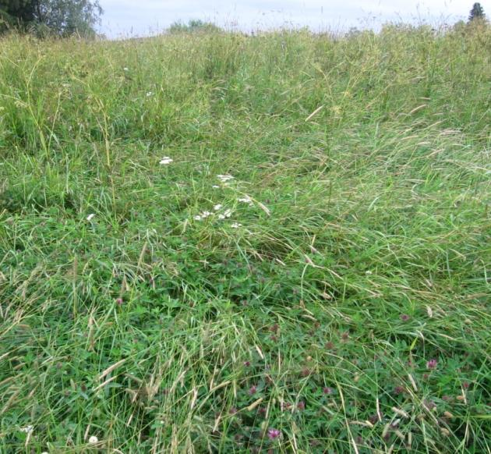
Grass area, minor changes
Number of ruminants, reduced 30 %
Grass area available due to reduced intensity | 205 000 hectars
Fallow area | 267 000 hectars
Alltogether | 472 000 hectars | Available for new applications
20 % of the agricultural area

Slide 4
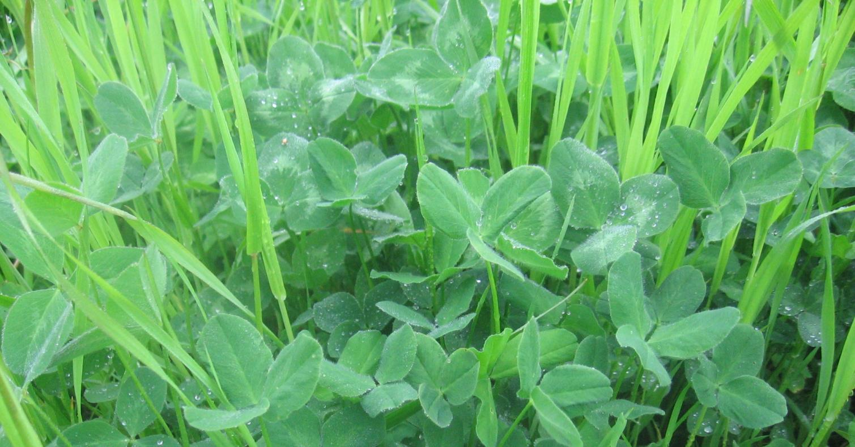
Leafy grass is really full of nutrients – but the fibre restricts its utilization by monogastricts
Leafy grass is susceptiple for rapid spoiling and nutrient losses as soon as it is cut

Slide 5
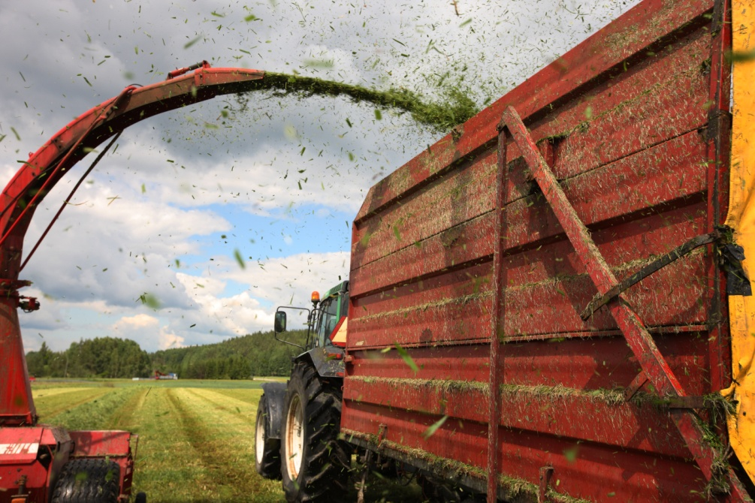
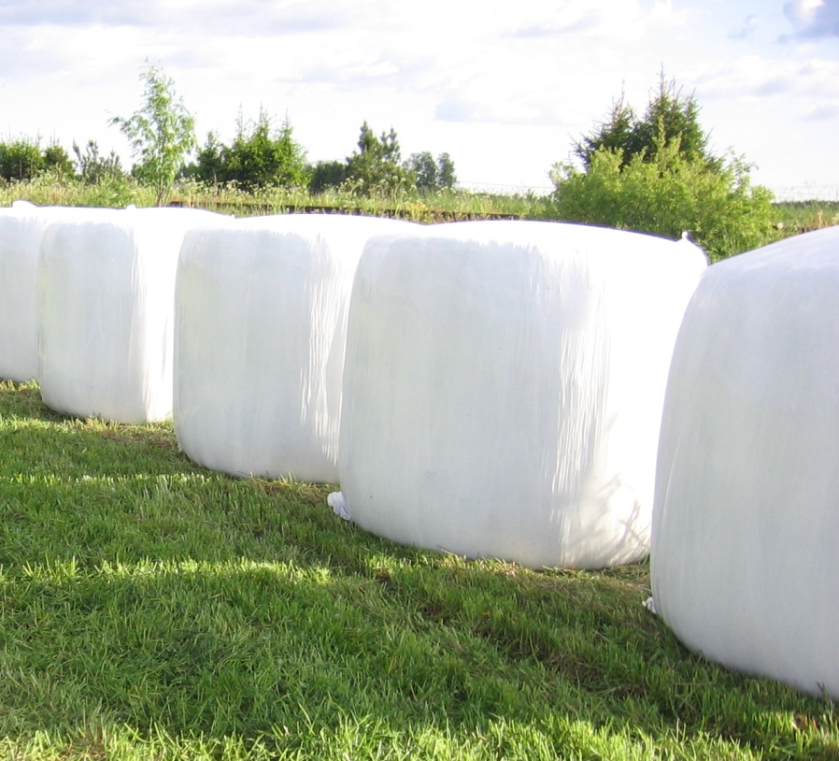
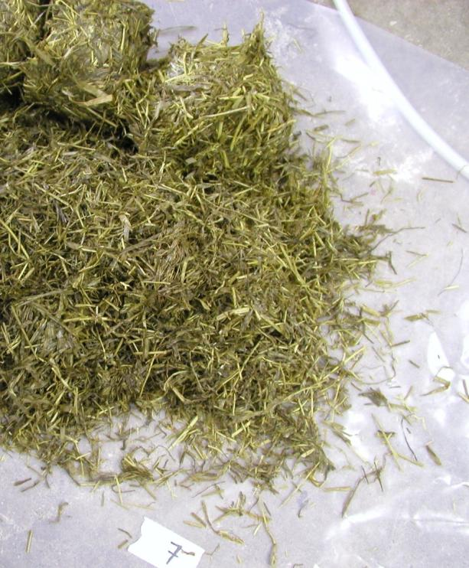
Nutrient rich leafy grass is ensiled to maintain the nutrients
Copyright: Janne Lehtinen/MTT
Grass silage would provide constant supply of high quality raw material for processing

Slide 6


Grass silage in Finland, typical composition (mean +- standard deviation)
 | Mean - stdev |  | mean + stdev
Dry matter (DM; g/kg) | 212 | - | 430
In DM (g/kg)
Digestible organic matter | 639 | - | 709
Cell wall fibre | 495 | - | 587
Crude protein | 120 | - | 173
Water sol. carbohydrates | 15 | - | 107
Lactic acid | 23 | - | 66
Volatile fatty acids | 2 | - | 23
Potassium (K) | 17.5 | - | 29.5
Calcium (Ca) | 3.0 | - | 6.6
Phosphorus (P) | 2.3 | - | 3.3
Data: Grass and clover silages from Artturi (1998-2012, n = 110192)

Slide 7
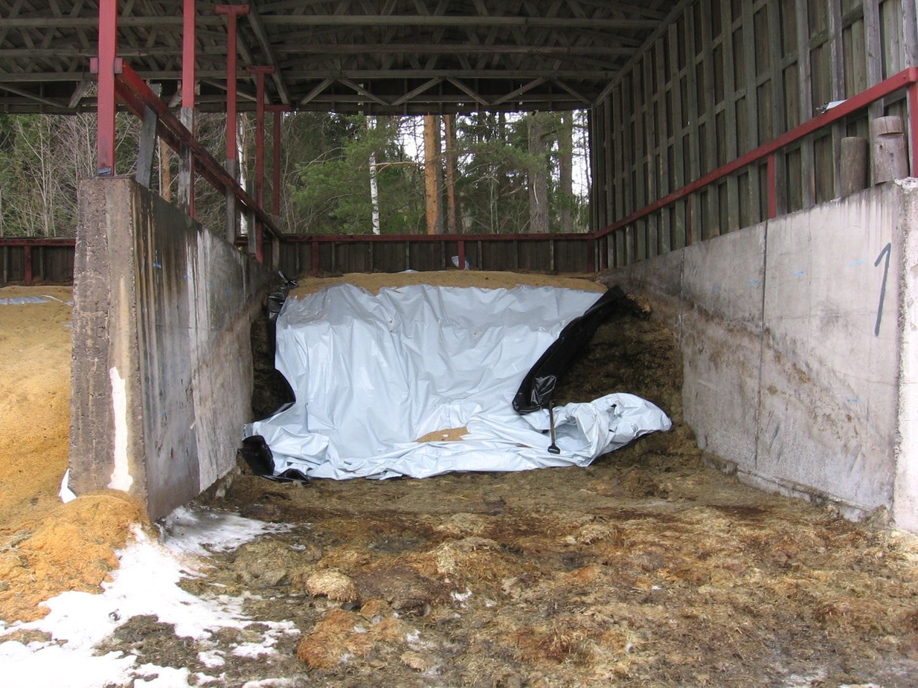
Grass silage used in the fractioning: second cut timothy-meadow fescue sward, summer 2012, harwested using farm scale machinery, cut, short prewilting and precision chopping, additive formic acid-based additibe AIV2Plus 5 l/t (formic acid 760, ammoniumformate 55, water 185 g/kg).
Silage silo opened in April 2013 and silage frozen for this project

Slide 8
Silage quality
Dry matter | ash | protein | NDF –fibre | Digestibility of the organic matter | Digestible organic matter
g/kg | g/kg DM | g/kg DM | g/kg DM | % | g/kg DM
241 | 115 | 138 | 524 | 79 | 646
Fermentation quality – not superior, but not bad
pH | ammonium N | Ethanol | Lactic acid | sugar | Acetic acid | Butyric acid
 | g/ total N | g/kg DM | g/kg DM | g/kg DM | g/kg DM | g/kg DM
4.19 | 69 | 29 | 69 | 14 | 21.0 | 0.66

Slide 9
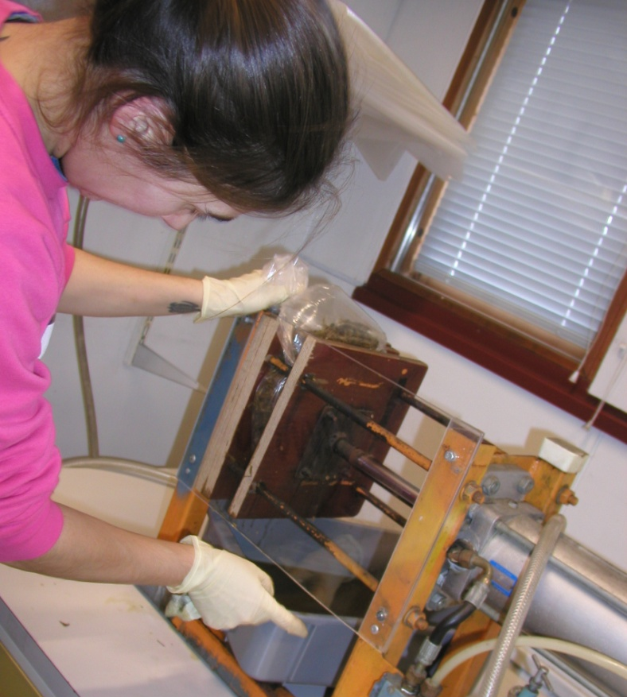
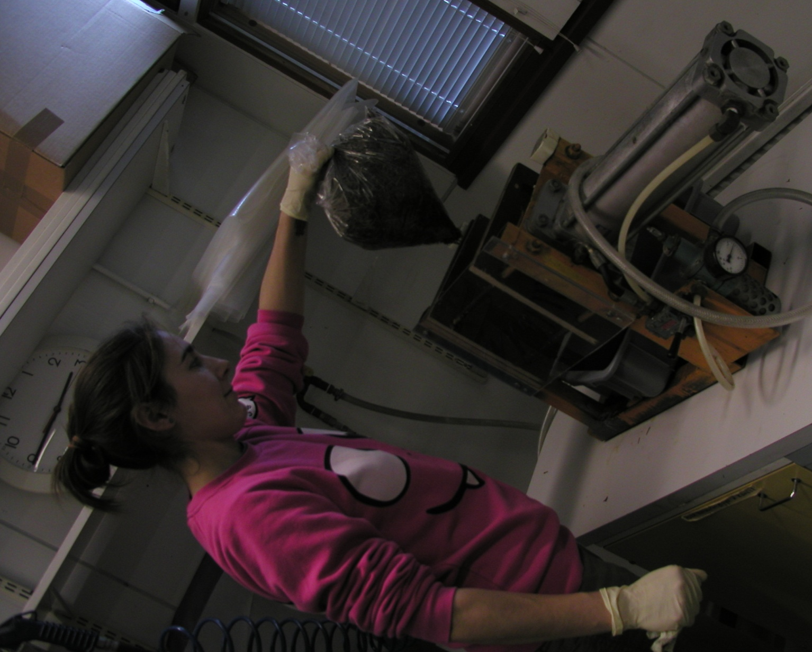
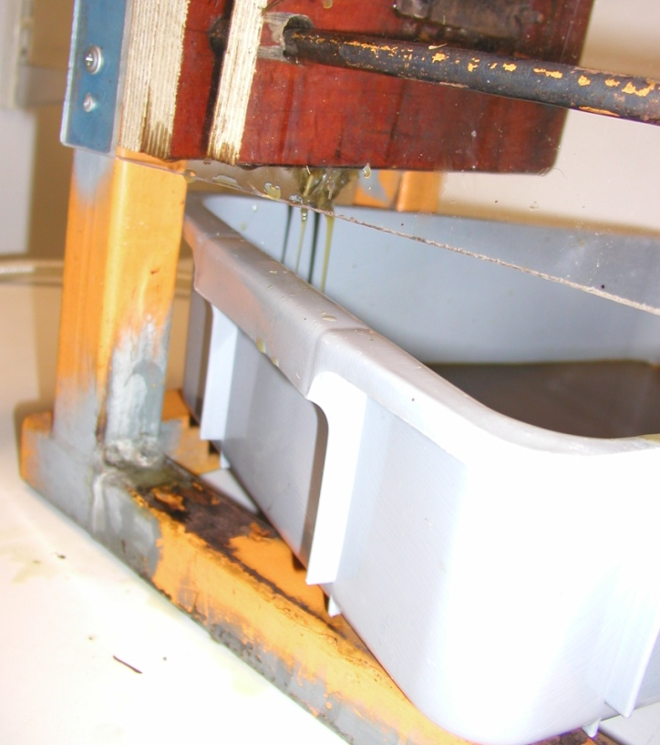
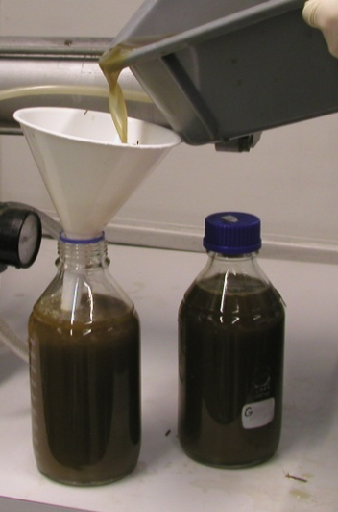
Press juice

Slide 10
 |  | Juice pressing, fractioning the silage
 | In 1 kg silage | To the juice % | To the cake %
Mass | 1000 | 30 % | 70 %
Dry mass (oven method) | 221 | 10 % | 100 %
ash | 25 | 23 % | 77 %
protein | 30 | 18 % | 91 %
Acetic acid | 5.1 | 34 % | 66 %
Lactic acid | 16.6 | 30 % | 70 %
Water soluble carbohydrates | 3.5 | 16 % | 84 %
P | 0.7 | 38 % | 62 %
K | 6.6 | 34 % | 66 %
Fibre | 116 | -15 % | 115 %

Slide 11
What is the price of grass silage?
In minimum the price should cover fertilization, harvesting, ensiling and transportation
Contractors for silage harvesting would take the biggest “slice of the cake” of silage price
The slice for the farmer would be quite marginal – just the more easy way to fulfill the terms of agricultural subsidies. According to the economical calculations done in Bionurmi-project that would be still interesting option for fallow area or for cereals if the price for cereals is not satisfactory.

Slide 12
Value of concentrated silage extract in pig feeding
 |  | Two recipes for liquid pig feeding (% of feed DM)
Feed components | Price, €/t | Without silage extract | Silage extract included ( 10 % DM)
Barley | 140 | 73 | 65
Wheat | 165 | 10 | 10
Soyameal | 500 | 13.3 | 11
Silage extract | 204 |  | 10
Rape seed oil | 1250 | 0.57 | 1.5
L-Lysin | 1400 | 0.34 | 0.37
L-Threonin | 2000 | 0.08 | 0.08
DL-Methionine | 2750 | 0.03 | 0.07
Monocalsiumfosfate | 500 | 1.04 | 0.78
Calciumcarbonate | 75 | 1.59 | 1.47
Added adid | 2000 | Dosage 2 l/liguid feed
Price of the mixture |  | 211 | 211

