Slide 1
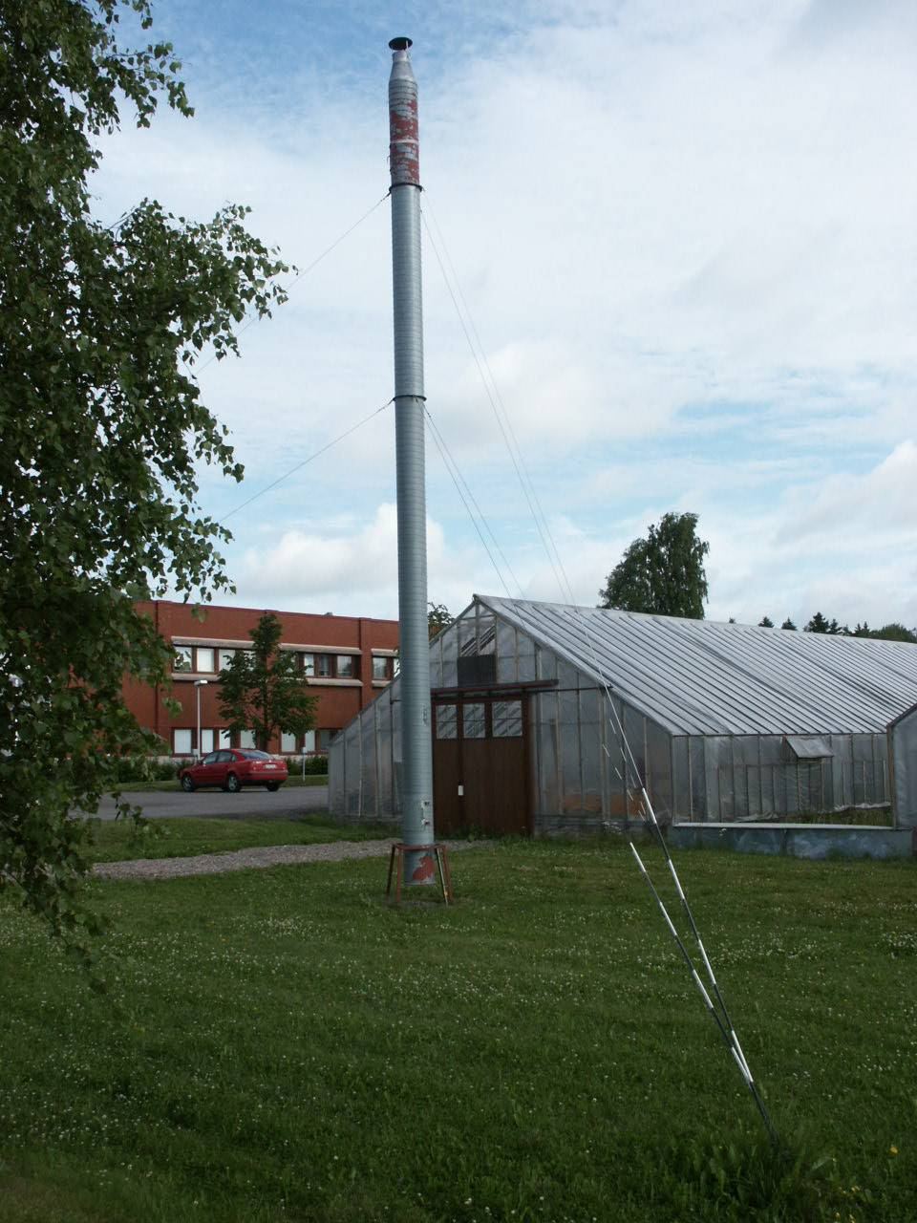
Suction traps in Finland
Irmeli Markkula &
Erja Huusela-Veistola
MTT Agrifood Research Finland

Slide 2
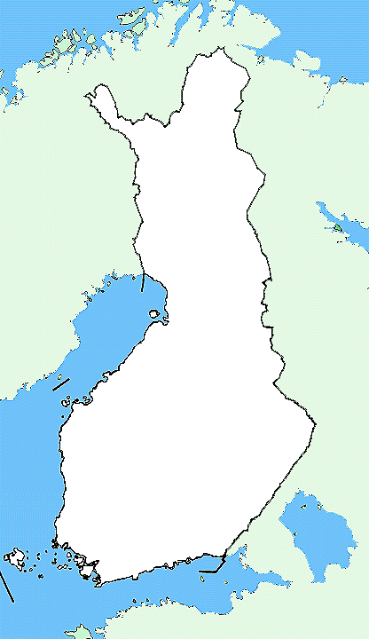
1985-2013
3 traps
During the growing season (April-October)
Twice a week
7 aphid species
Samples not kept
<1 staff
Funded by MTT
Tyrnävä
1996-
Jokioinen
1985-
Viikki
1992-

Slide 3
Uses of data
Information to growers:
- forecasts and warnings
- cooperation with weather radars & other traps
Time series:
- population dynamics
- pest appearance time & phenology
- composition of pest complex
- insect migrations

Slide 4
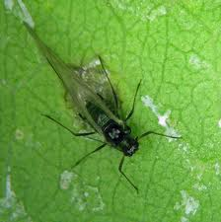
Outlook
only 2 suction traps working
2013 (Jokioinen and Viikki)
other insects?
funded by MTT 2014
=> Natural Resources Institute Finland ?

Slide 5
Thank you!

